Slide 1
Making a living as an independent mobile developer
Minh Tran
Principal developer at TranCreative LLC
Lone

Slide 2

About me
K37 Tin mềm ĐHBK Hà Nội
Started developing for WM as a hobby since 2002
Took 10 years to realize working for big companies brings neither fun nor money
Having apps for iOS, Android, WP, WM, WebOS, Bada, Mac, PC, all developed by self
Made first M from selling mobile apps

Slide 3
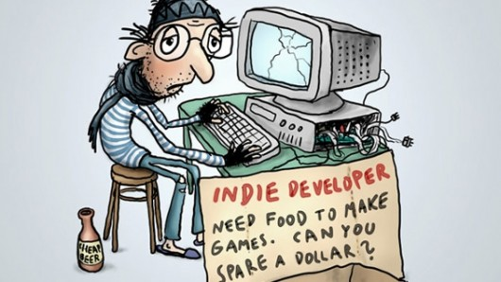
Typical indie mobile app developer
Develops by themselves for end users
Has no major upfront investments
Depends on income from selling apps

Slide 4
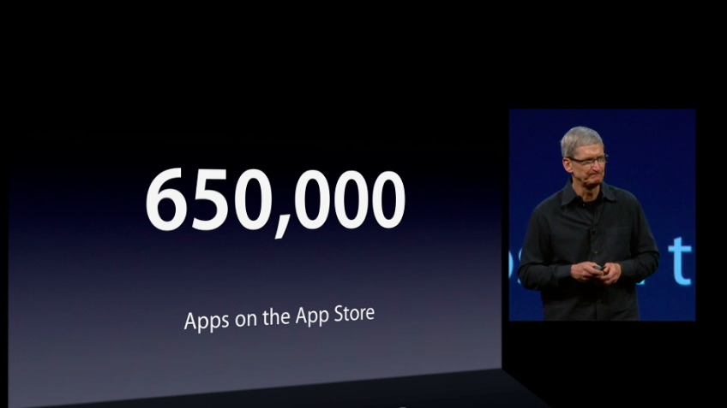
Is it possible to make a living by selling apps?

Slide 5
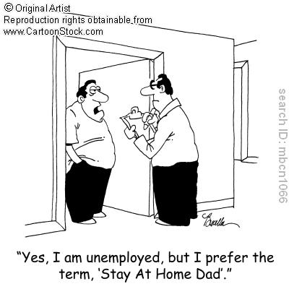
Easily, if you…
Have a working wife, or
Stay home with parents
If not, don’t quit your full time job yet,
let’s see…

Slide 6
Up front cost
Hardware – Macbook and a couple of devices
$2000 or more
Registration for a membership program
$99/year
Time to learn and to build first app
Priceless
© MasterCard

Slide 7

Which kind of apps to develop?
High quality apps targeting a lot of users
Niche apps for a vertical market
Custom apps for clients
Brand new type of apps that never exists before (possible?)

Slide 8
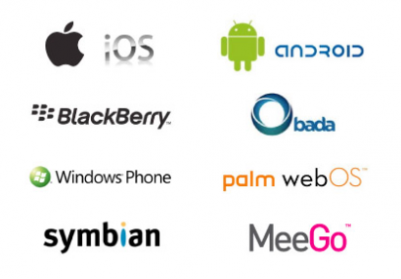
Which mobile platform?
iOS – Strongly recommended
Android – Recommended
Windows Phone – Good to have
Black Berry – Huh?
bada – What!
…

Slide 9

How to make a good app?
Passion / Eat your own dog food
Attention to details
Good UI – Less things on screen
Correct English
Sexy graphics

Slide 10

DIY vs. Hire
Are you good at it?
Do you have time?
Cost effective?
Typical costs for copy writing $50-100/page, icon designing: $300-$500/icon
Good contractors are expensive but OK contractors can be available at very low rate

Slide 11

How to make money
Traditional paid apps
In-app purchase
Free apps with advertisements (iAd, AdMob…)
Cross sell with other products
OEM contracts
Custom apps

Slide 12

How to launch/promote an app?
Hire professional for marketing copy writing
Time the first launch
Prepare media way before launch/update
Publish screencast videos (YouTube)
Create buzz around products - just talks about it everywhere - Twitter/Facebook/blogs
Buy ads/professional promotion

Slide 13

Build a long term business
Product update cycles
updates don’t bring revenue, but needed
Customer support/retain
really not that bad (unless the app is bad)
Think ahead of ways to sell to existing users
Build a fan base, make users do marketing works for you

Slide 14

Other tips/recommendations
Look for solutions in open source projects
Solve a popular problem with a unique UI
Start small
KISS
First release is very important
Don’t be put off by existing products

Slide 15

What is my chance of making $
Top 200 iOS app in a category: 100s copies/day
Top 200 iOS app in entire store: 1000s copies/day
Top 10 iOS app in entire store: 10000s copies/days
iAds/Ad Mobs: eCPM ~ $2.00
➔ you need at least one app in top 200 of a categories or 100 thousand impressions/day to make a good living

Slide 16

It’s not easy, why bother?
Working for self feels good + Freedom
Able to do a lot of things and learn a lot of skills
Successful apps have very
long tails to live off
Have a chance to make
big money

Slide 17

When should I quit my full time job?
Have a successful app that is bring in 4x your day job
Need to find more time for both jobs
Have a solid idea to stay sane working alone most of the time

Slide 18
Questions & Answers

